Slide 1
IdleLock™
Secure Idling with Key Removed
12840 Earhart Ave.
Auburn, CA 95602
(530) 823-1048
www.InterMotive.net

Slide 2
What is IdleLock?
Anti-theft system that allows the vehicle to idle with the key removed from the ignition and the transmission locked in Park
All lights, equipment and HVAC fully functional while engaged
Activated by pressing an enable switch and removing the key; inserting the key and turning it to the run position restores normal operation

Slide 3
IdleLock Features
If an attempt is made to shift out of Park without the key in the ignition, the horn will sound and the shifter will lock in Park
If the shift lock is broken, IdleLock will turn off the engine
Police applications: IdleLock will disable the trunk and gun rack release buttons

Slide 5
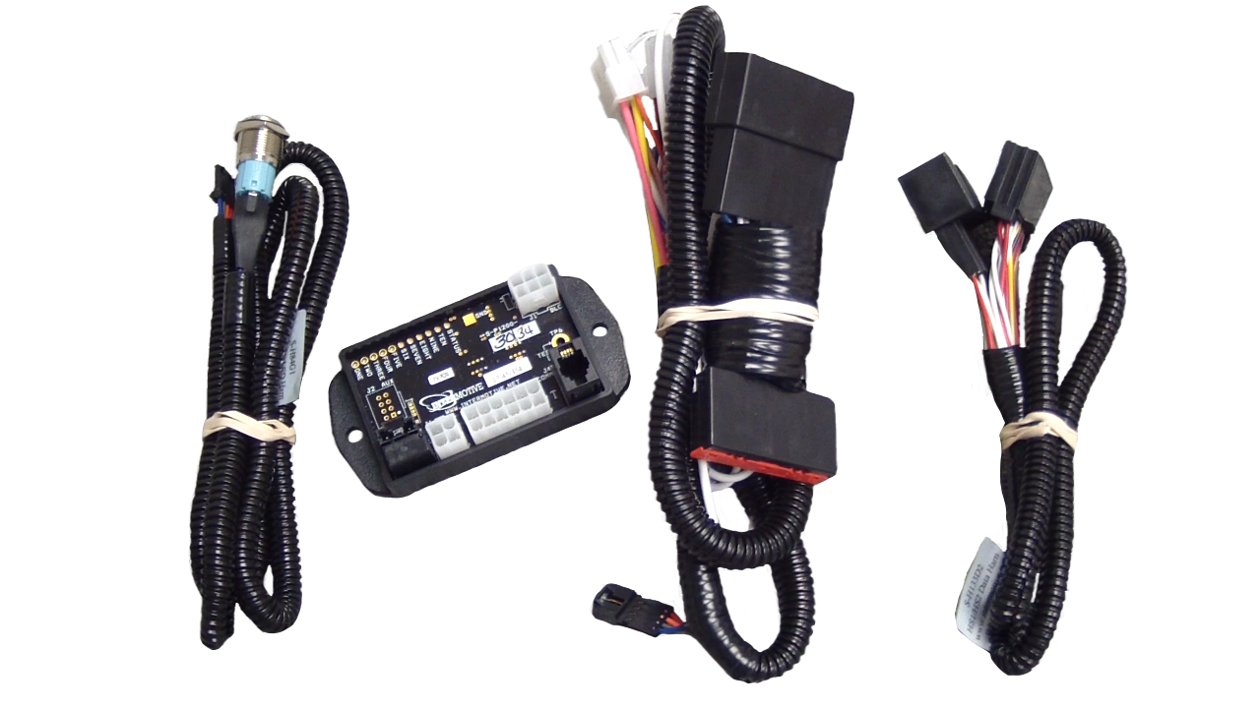
Easy Installation
Plug and play connections to the data link/gateway and the ignition switch
No cutting of any factory wires
Easy diagnostics and simple return to OEM state if needed

Slide 6
For more information, contact:
InterMotive: (800) 969-6080 | www.InterMotive.net
LGS Group (master distributor): (775) 831-2002
Or your local dealer

