Slide 1
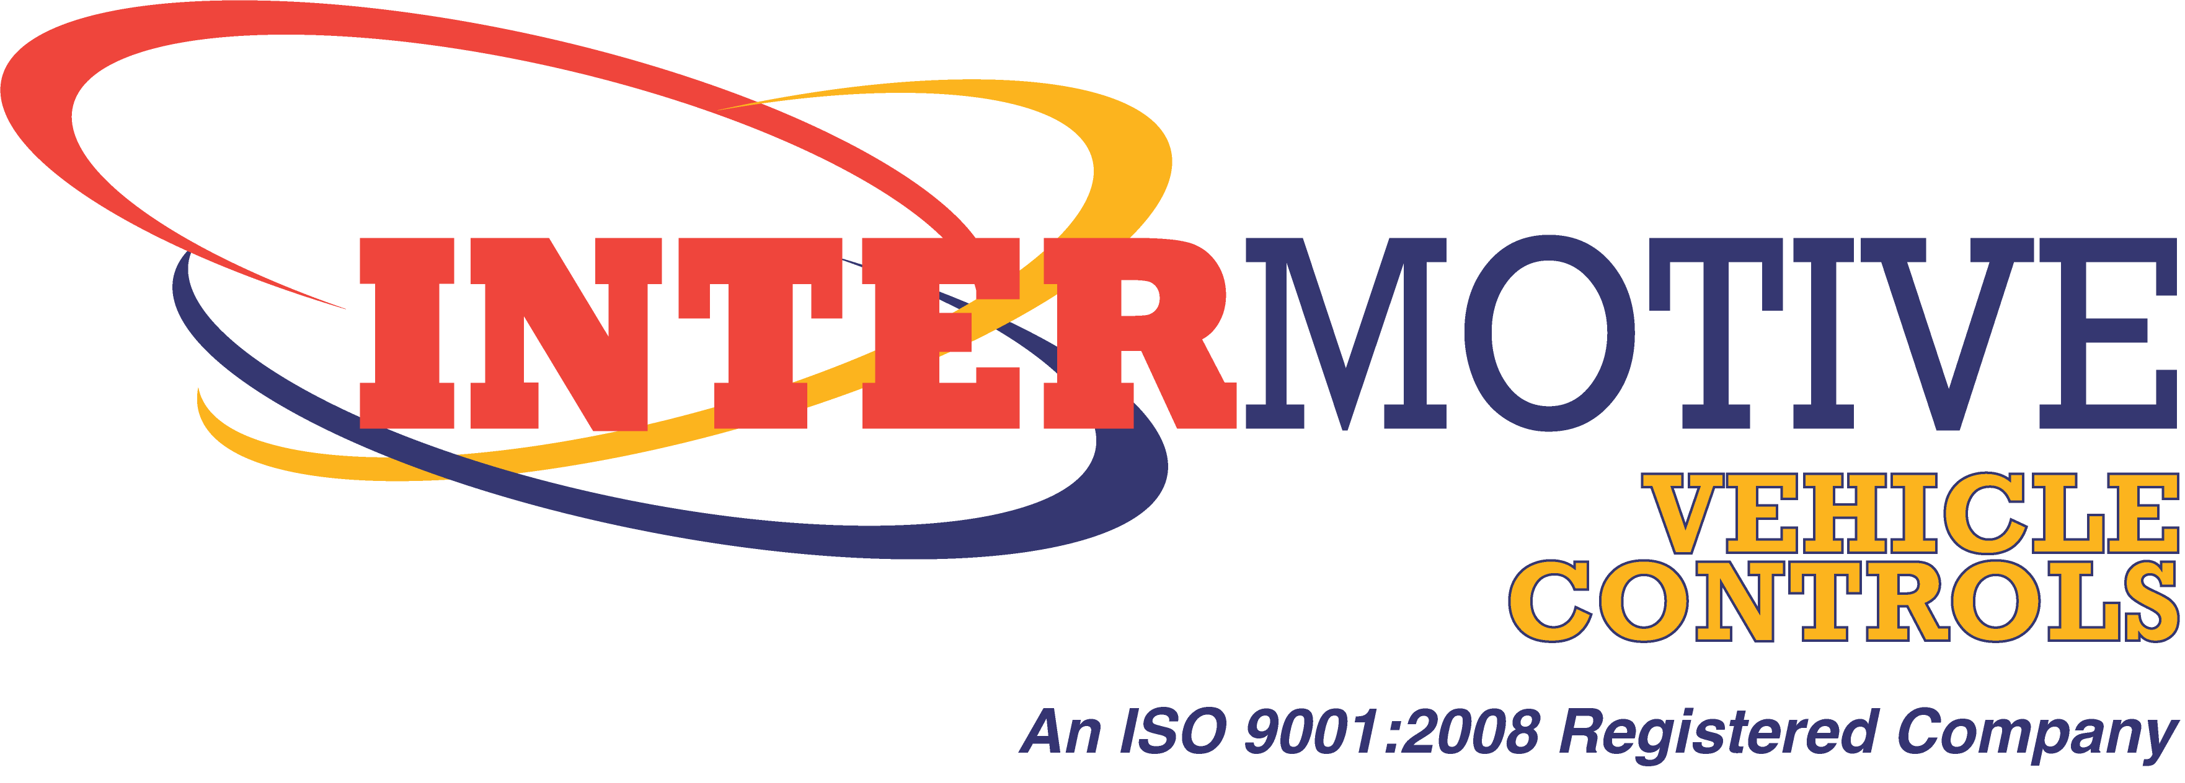
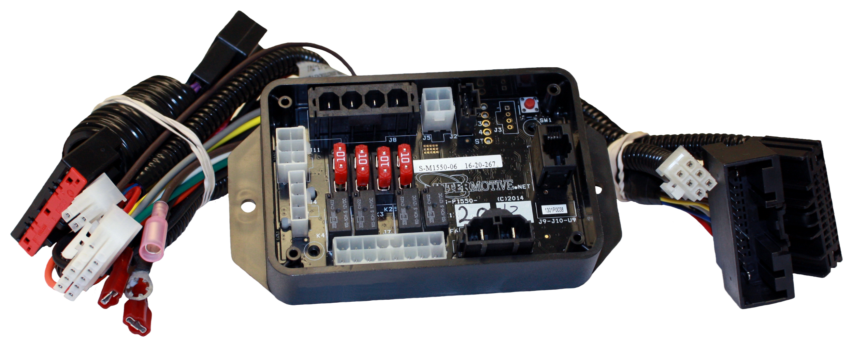
EcoStar™III
Idle Reduction System with Key In/Out
12840 Earhart Ave.
Auburn, CA 95602
(530) 823-1048
www.InterMotive.net

Slide 2
Why EcoStar III?
Idle reduction system benefits:
Optimizes fuel economy; may cut idle time by as much as 50 percent
Reduces engine wear and lowers harmful emissions (helps meet anti-idling regulations)
High idle helps with better AC performance and quicker battery charge

Slide 3
Vehicle Security
EcoStar III works with the key either in or out of the ignition
Key out keeps the vehicle secure with the transmission locked in Park
Activated by pressing an enable switch and removing the key
Inserting the key and turning it to the run position restores normal operation

Slide 4
Mobile App Technology
EcoStar III system uses Bluetooth and a free mobile app to:
Pull data for tracking idle time reduction and fuel savings
Set parameters for custom conditions enabling the engine to turn off and on
Manually start/stop the engine remotely within Bluetooth range

Slide 5
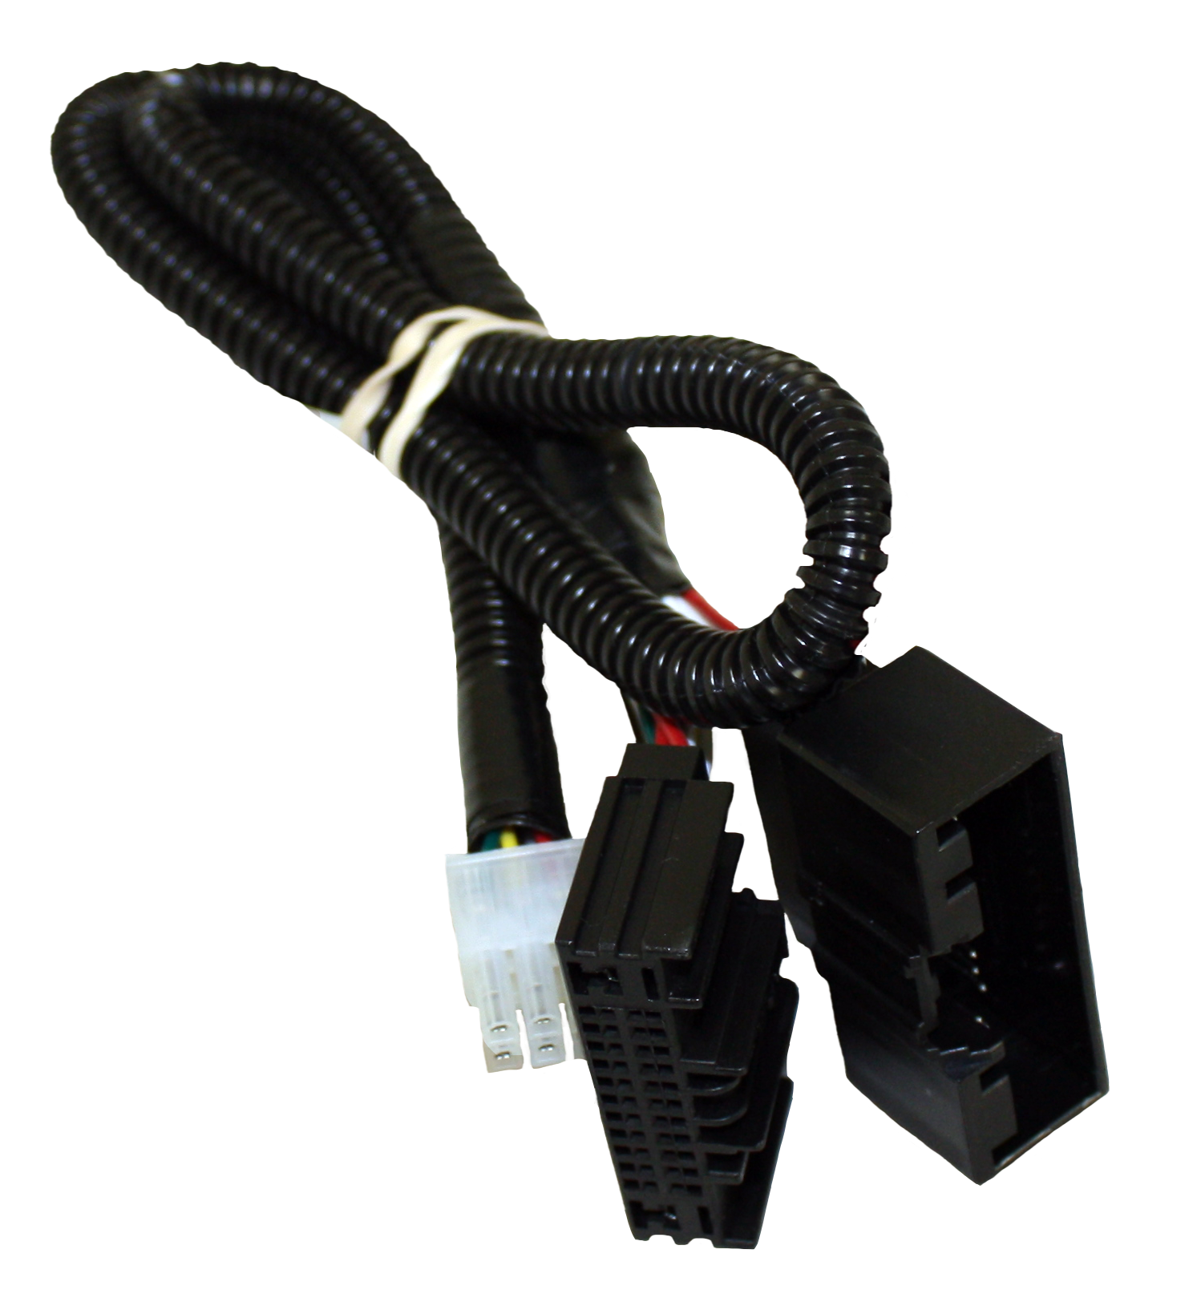
Easy Installation/Diagnostics
Plug and play connections
Industry trend moving from OBD to gateway connector
Custom connectors for gateway
No cutting of any factory wires
Easy diagnostics and simple return to OEM state if needed

Slide 6
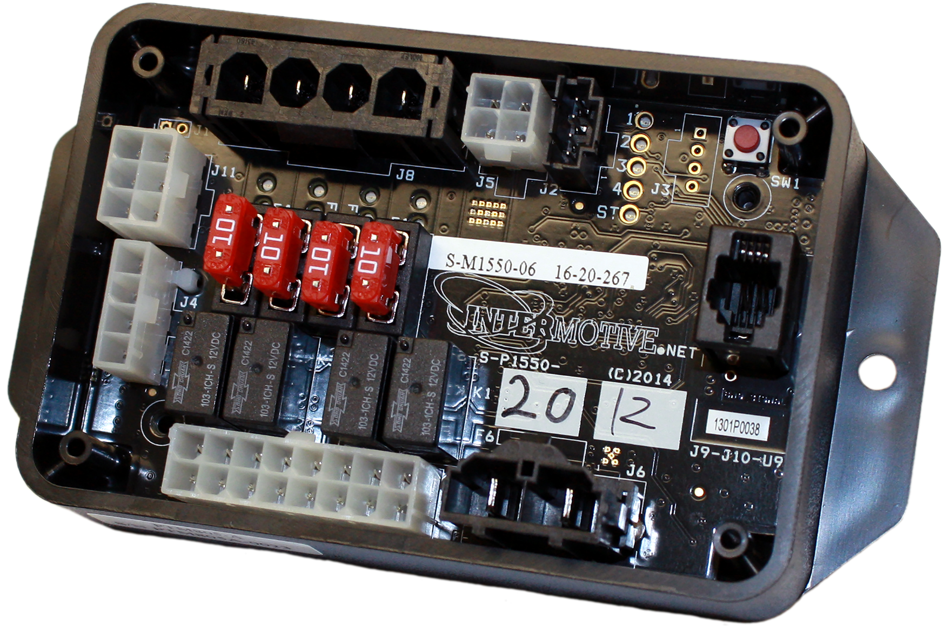
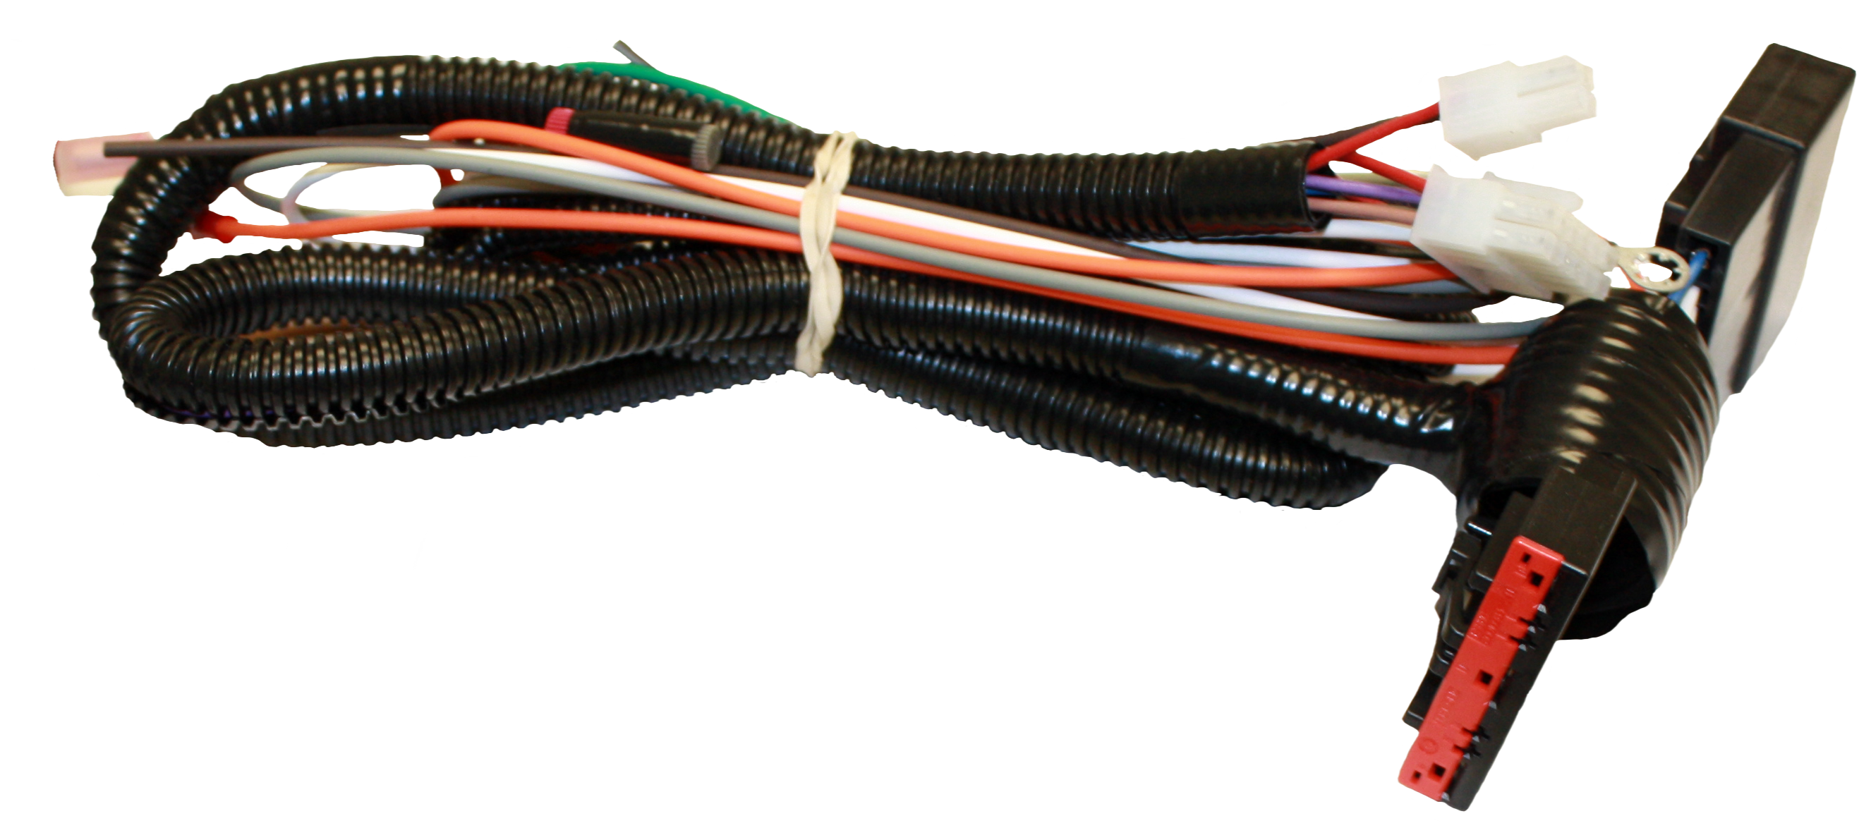
EcoStar III Kit Components
Custom Gateway Connector
Mini-R Module
Ignition Switch

Slide 7
For more information, contact:
InterMotive: (800) 969-6080 | www.InterMotive.net
LGS Group (master distributor): (775) 831-2002
Or your local dealer

